Slide 1
EURIPIDES², Smart Digital Embedded Systems
©EURIPIDES²
Praha - 31 June 2018

Slide 2
Summary
I EURIPIDES² scope
I International Board
I Winning proposal
I Call process
I Funding
I Success stories
I Calls 2018
2

Slide 3
1. EURIPIDES² scope

Slide 4
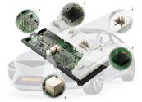
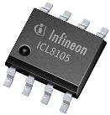
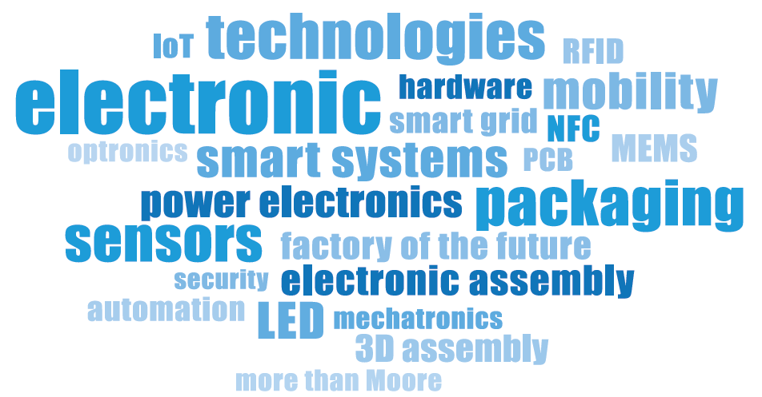
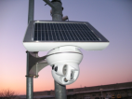
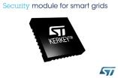
EURIPIDES² Smart Electronics Systems
Credits: Infineon, CEA-LETI, Eryma, STMicroelectronics, Continental, VTT
4

Slide 5
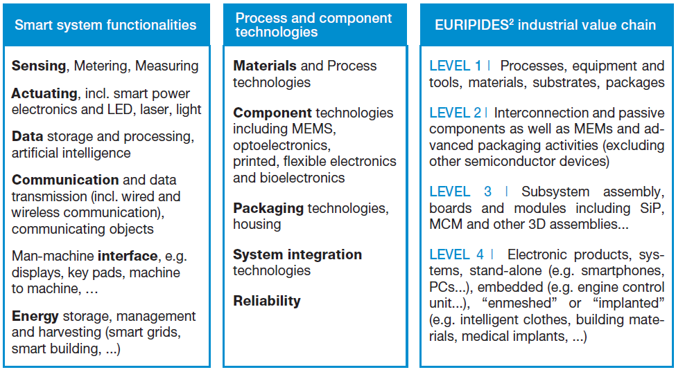
EURIPIDES² Smart Electronics Systems
Download the Vision Mission and Strategy document

Slide 6
R&D&I Strategic Research Agenda Roadmap
KEY APPLICATION AREAS >
Systems and Components
Architecture, Design & Integration
Connectivity & Interoperability
Transport & Smart Mobility
Health & Well-Being
Energy
Digital Industry
ESSENTIAL CAPABILITIES
Safety, Security & Reliability
Digital Life
Computing & Storage
ECS Process Technology, Equipment,
Materials & Manufacturing

Slide 7
2. International Board

Slide 8
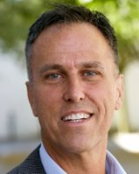
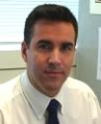
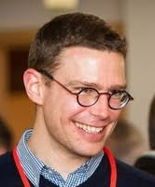
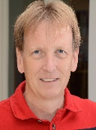
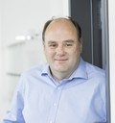
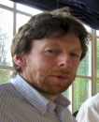
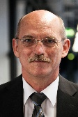
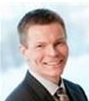
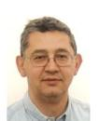
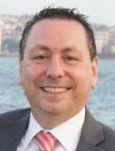
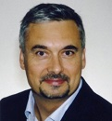
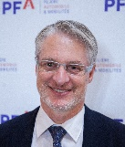
From Canada to South Korea
Ken Brizel Michael Salter Hervé Mokrani Heinz Moitzi Marek Valdmann Normand Bourbonnais Bernard Stree Jochen Langheim
André Perret
Stefan Finkbeiner Hoyoung Hwang Johan de Baets Klaus Pressel Klaus-Dieter Lang Burak Aydin Ansi Korhonen
Jean-Luc Diot Julien legrand David Hania Cem Ulger Gilles Pradel Philippe Kertesz
Open
Innovation Club
An Nguyen-Dinh Eric Poyeton Jyrki Kiihamaki
18

Slide 9
Coaching Application domains
EURIPIDES² Chairman
Jochen Langheim
Vice Chairman
Security
Vice Chairman
Aeronautic
Vice Chairman
International Relations and SMEs
Vice Chairman
Intelligent Transportation Systems
Vice Chairman
Smart Home
Hervé Mokrani
David Hania
Ken Brizel
Burak Aydin
Gilles Pradel
9

Slide 10
3. Winning proposal

Slide 11
The equation
Innovation
New products
Significant improvement of existing solutions
Winning
EURIPIDES²
Proposal
Consortium
Balanced
At least one company per country
National eligibility
Fair share of R.O.I.
Impact on employment
Production
11

Slide 12
Check list
Is my idea in the EURIPIDES² scope?
Check with our Office
Is the innovation demonstrated?
Do I miss partners in the value chain?
Our Office can help you finding partners
Is the ROI fairly shared between industrial partners?
Did I check the funding rules?
Look at the EURIPIDES² web site “Public funding”
Do I have a case at national level?
Contact your national representative
How to improve my proposal and make my life easier?
Get a free consultation with our Office at the earliest stage
12

Slide 13
4. Call process

Slide 14
Ensuring maximum success
2 calls per year
2 steps procedure
Participants from at least 2 EUREKA countries
Not more than 75% for one country
Innovation
Demonstrators - Products
Market
Fair Return on Investment for each industrial partner
14

Slide 15
Call process
Two external experts
Technical Committee comments
EURIPIDAC outlook on funding potentialities
Project Outline (PO)
Innovation and objectives
Consortium (even if not fully settled)
10-12 pages
Full Project Proposal (FPP)
Innovation
Partners and organisation
Budget
Deliverables and milestones
Market and exploitation
Risk evaluation
30-40 pages
Two external experts
Evaluation report from the TEC
EURIPIDAC second round on funding
15

Slide 16
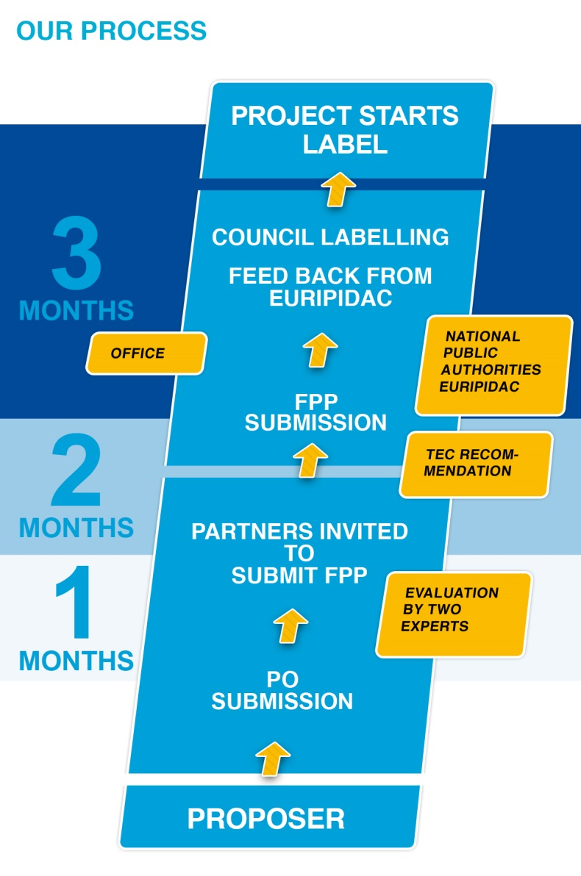
Call For Proposal Process
Basic Principles
TRL 2
Technology Concept
Proof of Concept
TRL 1
TRL 3
TRL 4
TRL 5
TRL 6
TRL 7
TRL 8
TRL 9
Laboratory Validation
Environment Validation
Prototype or demonstration
System in Environment
Test and Demonstration
Successful tests
16
Notes:
The council labels the proposal

Slide 17
6. Funding

Slide 18
EUREKA members commitment
20 Members supporting:
Austria, Belgium, Canada, Czech Republic, Estonia, Finland, France, Germany, Ireland, Israel, Hungary, Norway, Monaco, Poland, Romania, South Korea, Spain, Sweden, Switzerland and Turkey
18
Notes:
EURIPIDAC: Austria, Belgium, Czech Rep., Finland, France, Germany, Hungary, Ireland, Netherlands, Poland, Norway, Sweden, Spain, Switzerland, Turkey, Canada, South Korea

Slide 19
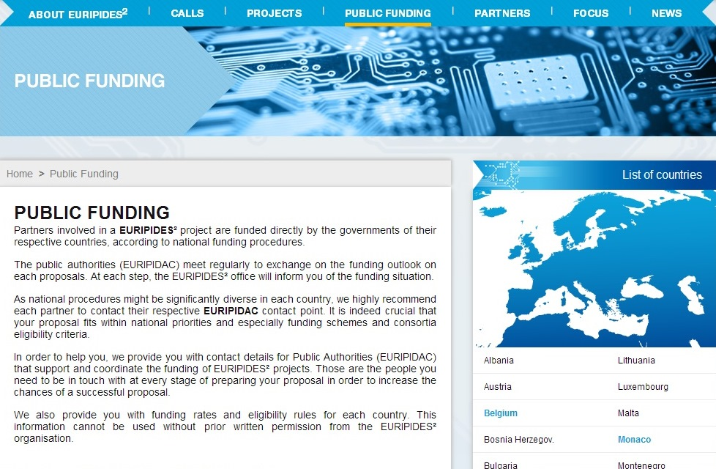
Funding
Funding is decided at national level
One “promoter” per country involved: mandatory to ensure the funding availability in all countries involved
Check the funding rules on the E² website
30

Slide 20
7. Success Stories

Slide 21
Running projects
PAMIAQ: Sensor for indoor air quality. 3,1 M€
ADVANTEX: Smart protective clothing with integrated sophisticated microsystems. 5,9 M€
ASES: High Efficiency Alternative Solar Energy Source. 3,2 M€
FLEXIDIS: Flexible Digital X-ray Imaging System. 1,7 M€
SAM3: Smart Analysis Methods for 3D Integration in Advanced Microsystems and Corresponding Materials. 19 M€
EDDEMA: Embedded Die Design Environment & Methodology for Automotive Applications. 5,6 M€
32

Slide 22
ADORAS – Improving security on railways
ADORAS Improving security on railways
Start: 2015
End: 2018
Cost: 5,5 M€

Slide 23
ADORAS: Advanced Onboard Data Recording and System Analysis
System integrator
Video camera
Sign recognition
Obstacle recognition
Geolocalisation
Communication architecture
Data processing
Wearable sensors
Train driver
Video search

Slide 24
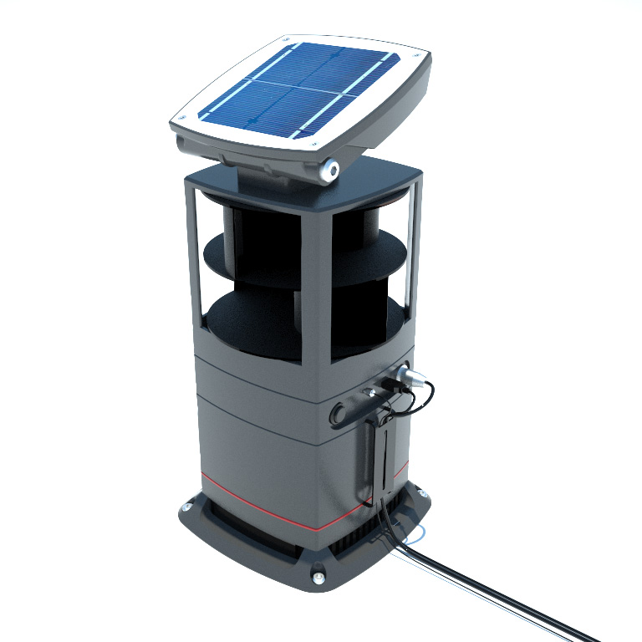
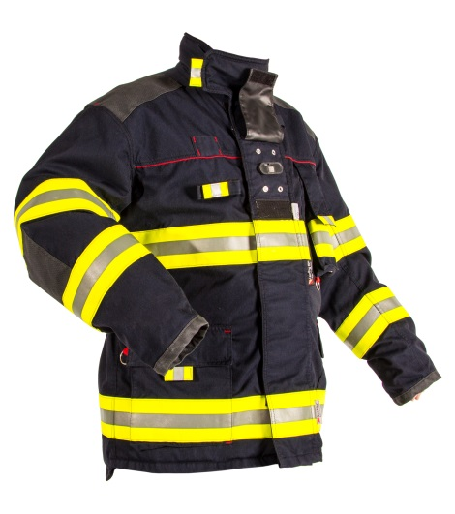
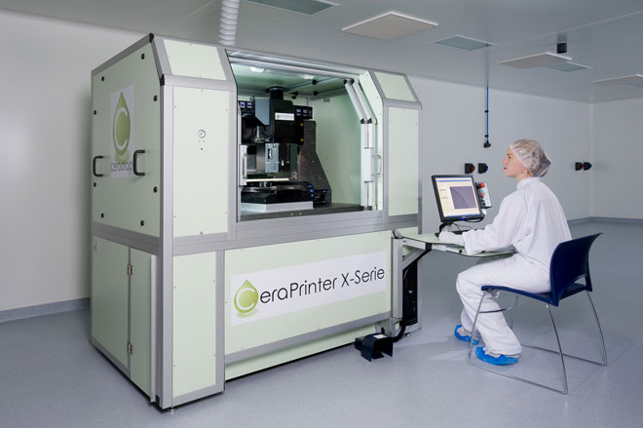
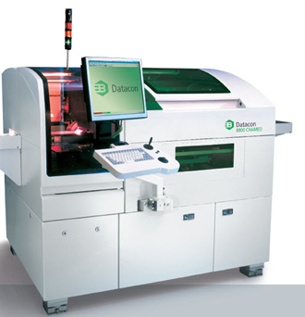
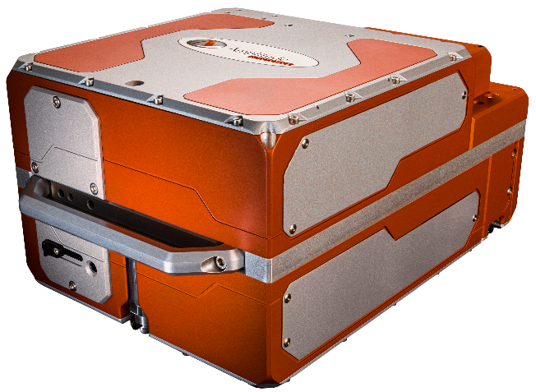
Projects Products
Credits:
24
Notes:
Pictures from left to right
ENERPACK Eryma Multi low power energy source packaging
CERADROP CERAMJET Electronic components on ceramics by Ink jet printing
INTEX
COSY 3D Datacon (Austria) DC 8800 CHAMEO Multi Flip Chip Bonder
UPMOST laser
THOR

Slide 25
7. Calls

Slide 26
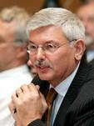
Call 2018
Spring call
Project Outline (PO): 12 March 2018
Full Project Proposal (FPP) : 07 June 2018
Autumn call
Project Outline (PO): 24 September 2018
Full Project Proposal (FPP) : 03 December 2018
The EURIPIDES² Office is your partner!
Rémy Renaudin
Office Director
26

Slide 27
PENTA & Euripides² Synchronised 2018/2019 Call Timing
PROJECT IDEAS GENERATION
CONSORTIUM BUILDING
PROJECT SUBMISSION
20/11 2018
Brokerage event
01/03 2019
PO Submission
18/09 2019
FUNDING & LABELLING
15/01 2019
Consortium Building
FPP Submission
28/05 2019
20/05 2018

Slide 28
ECS Collaboration Tool
Main Features
Online collaboration tool for open consortium building, independent of the funding instrument
Set up project teams, invite partners, exchange messages and showcase capabilities
Free-to-access and available 365 days/year
Project ideas resulting from the ECS CT can flow into any funding instrument
https://ecscollaborationtool.eu/

Slide 29
Looking for partners
We can help you finding partners
Provide us with a few lines on the research topic and profile of partners
Distribution to
News letters: 8000 contacts
Networks: public authorities, industry associations, regional networks and many more…
We never disclose who you are, but…
We forward you all requests…You have the choice!
On average, each publication generates 10 contacts
The EURIPIDES² Office is your partner
29

Slide 30
Contact remy.renaudin@euripides-eureka.eu www.euripides-eureka.eu Join us on Thank you !

