Slide 1
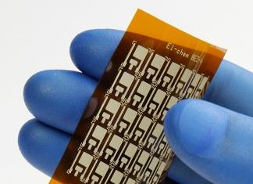
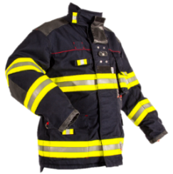
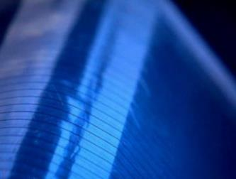
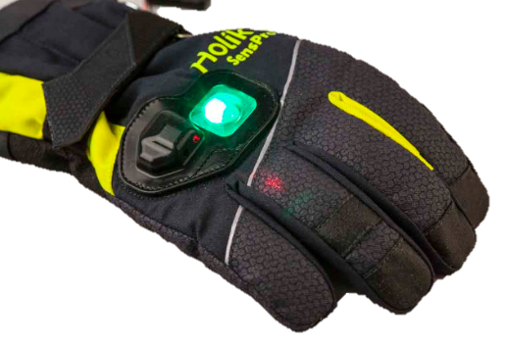
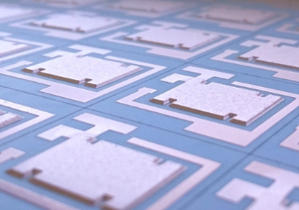
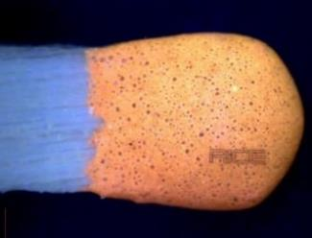
EUREKA Clusters Info day
Ministry of Education, Youth and Sports
31st May, 2018
Testimony of the University of West Bohemia in EURIPIDES² projects
Radek Soukup

Slide 2
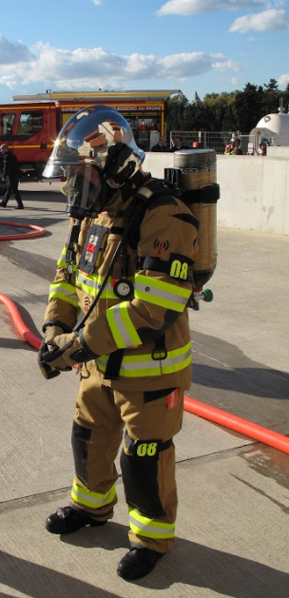
Agenda
Short introduction - University of West Bohemia
Experiences with EURIPIDES projects
2.1 INTEX project
2.2 ADVANTEX project
2.3 ASES project
3. Conclusions

Slide 3
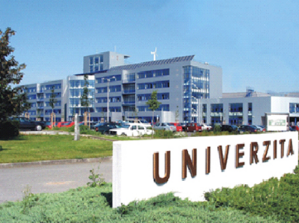

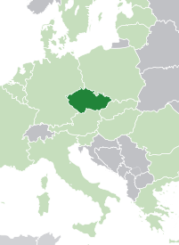
1. Short introduction - UWB
University of West Bohemia
City | Pilsen (CZ)
Founded in year | 1991 (1950)
Number of employees | 2032
Number of students | 14 500
Annual sales | 79 million €
Core business | University, Research institute
FACULTIES AT THE UNIVERSITY
Faculty of Applied Sciences
Faculty of Economics
Faculty of Electrical Engineering (FEE)
Faculty of Education
Faculty of Law
Faculty of Mechanical Engineering
Faculty of Health Care Studies
Faculty of Art and Design
PILSEN

Slide 4
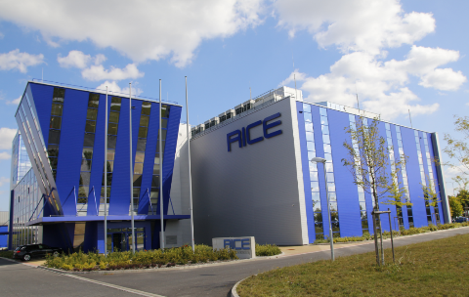
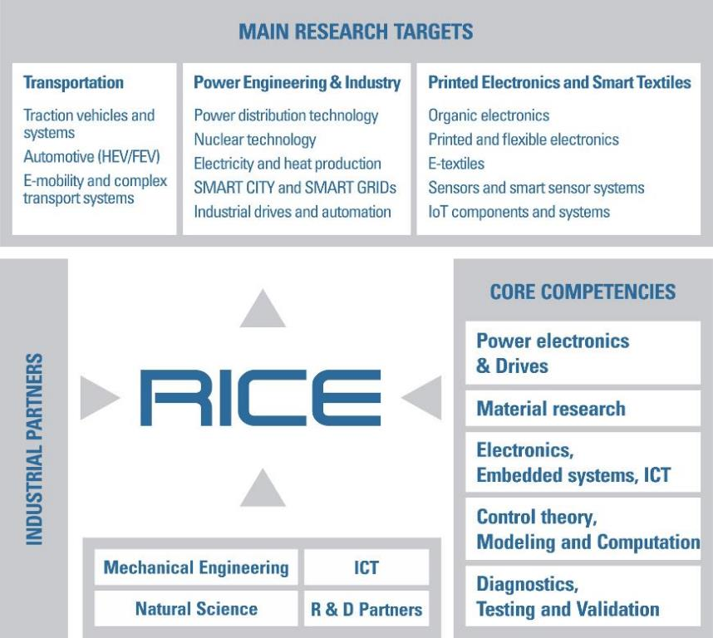
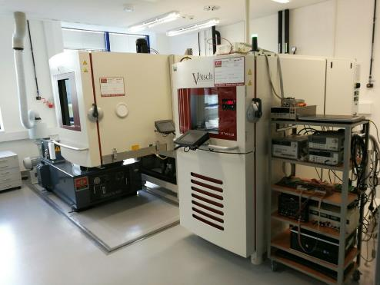
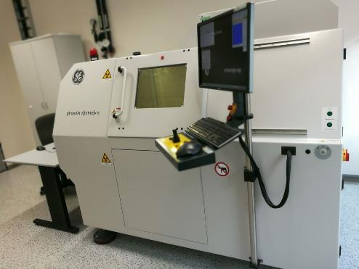
1. Short introduction - RICE
1400 m²
115
R&D workers
Laboratories
2013
Established
25 M€
Investment

Slide 5

2. Experiences with EURIPIDES projects

Slide 6
2.1 INTEX Project
The first experience with EUREKA EURIPIDES Project.
6 partners from 4 countries (leader TESLA Blatna)
Czech Republic (TESLA, University of West Bohemia)
France (CEA-Leti, Polytrame)
Germany (KIWO)
Switzerland (BOPP) c
Intelligent Sensing and Communicating Textile
NEW TECHNOLOGIES
Ultra fine line and thin screen printing:
Line/gap down to 40 µm, film thickness down to 0.4 µm.
Advanced screen printing on textile:
Conductors, antenna structures.
Project start: 01. 05. 2010
Project finish: 30. 04. 2014
Project budget: 3,02 M€
Microsystem integration into textile products: Interconnection, encapsulation, communication.

Slide 7
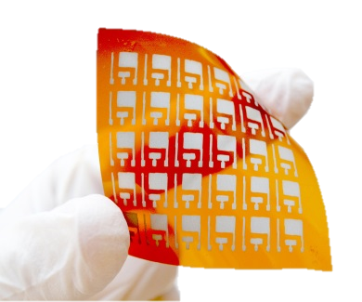
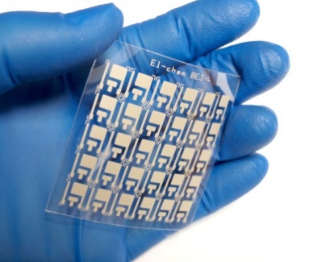
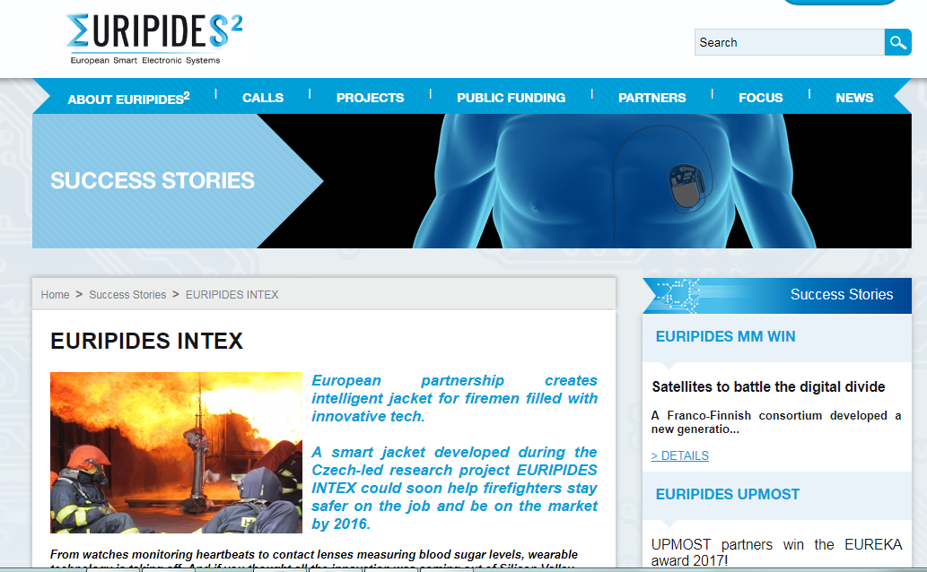

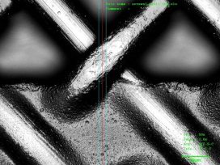
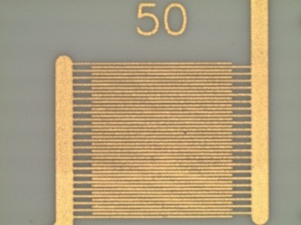
2.1 INTEX Project
Intelligent Sensing and Communicating Textile
Screen printed electrochemical sensors on flexible substrate.
20
μm
30
40
Screen printed lines and IDE structures, line width down to 40 μm, thickness of patterns down to 0,4 μm.

Slide 8


Slide 9
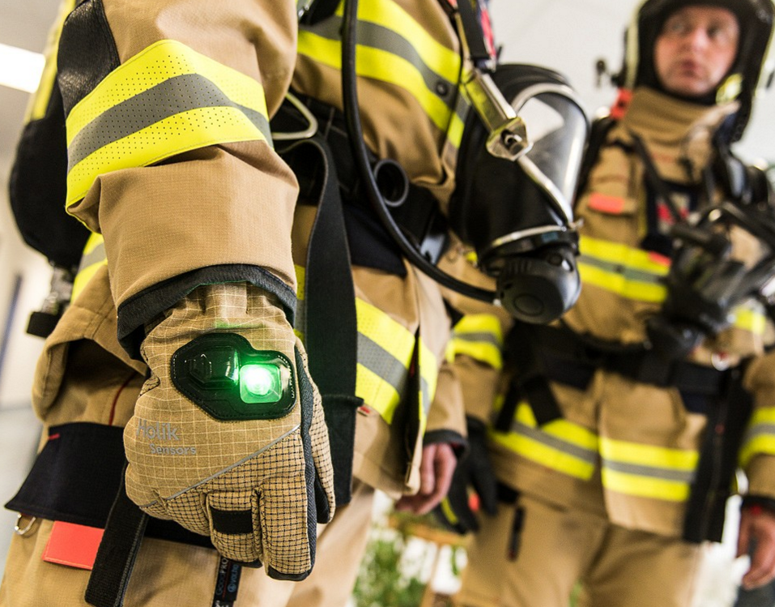
ADVANTEX project

Slide 10
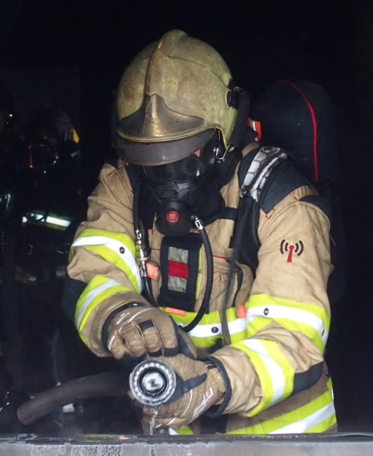
2.2 ADVANTEX Project
ADVANced functional blocks and technologies for smart
Project duration |  | June 2014 – May 2018
Program, Funding provider |  | EURIPIDES2 - EUREKA, MSMT (CZ)
Project objectives
Smart firefighter suit, protective gloves and boots Online monitoring of heat capacity of the suit. Motion tracking inside buildings (ded-reckoning trajectory) Dangerous gas detection (based on MEMS and NEMS) UHF RFID communication link for remote power of low power and battery-less sensors (868 MHz).
Fields of application
Smart firefighter protective suits, Smart protective suit for petrochemical, energy, construction, waste and recycling industry
Consortium overview | CEA-Leti (F), UWB (CZ), APIX (F), Applycon (CZ), InvenSense (F), Holik (CZ), VOCHOC (CZ)

Slide 11
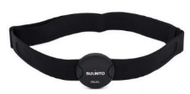

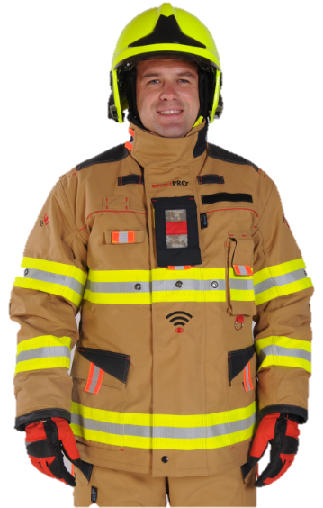
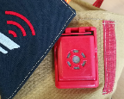
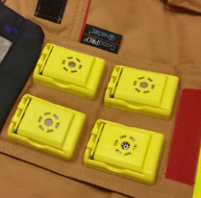
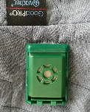

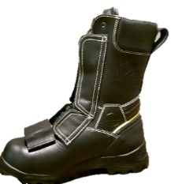
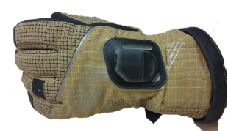
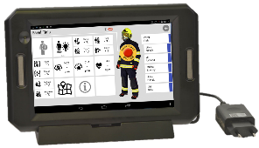
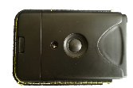

2.2 ADVANTEX Project
HR module.
Integrated temperature sensors.
All electronics are encapsulated.
The SCU and sensor modules are removable.
Interconnection system is resisted against automatic washing and connecting points are fixed.
System is based on building blocks therefore it is easy to replace in case of failure or damage.
Alarm
module.
Sensor modules.
Integrated illumination.
Mpod inertial localization system integrated to the boot.
868 MHz
Smart glove with integrated thermocouple and IR temperature sensor.
Suit control unit (SCU).
Commander control unit (CCU).

Slide 12
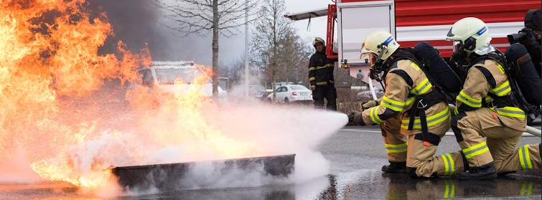
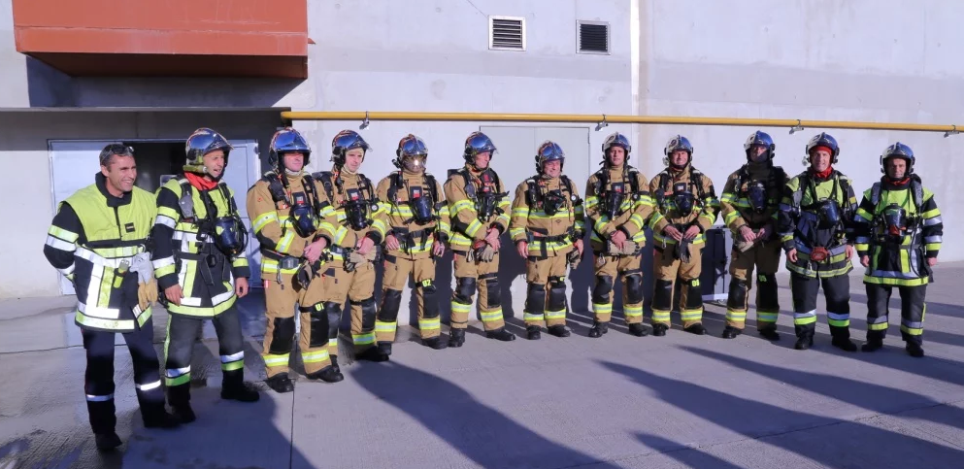
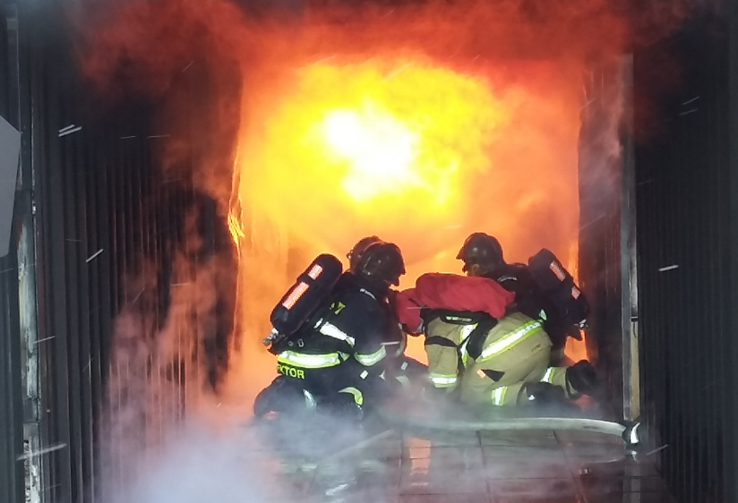
2.2 ADVANTEX Project
video

Slide 13
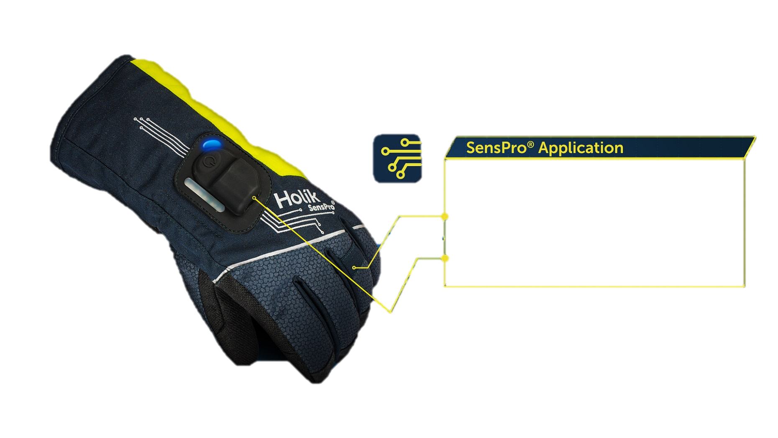


2.2 ADVANTEX Project - SenPro
1400 m²
Configuration of temperature limits
Thermocouple sensor
Temperature IR sensor

Slide 14
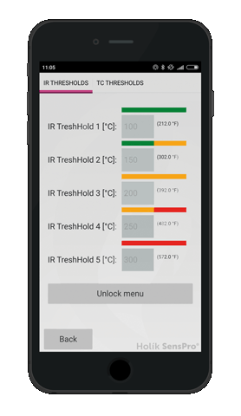
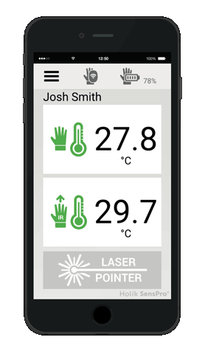
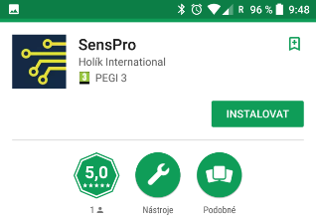
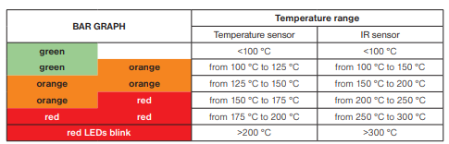
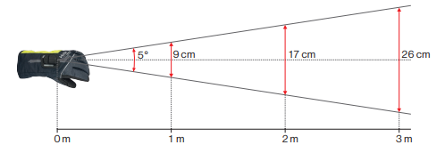
2.2 ADVANTEX Project - SenPro
SensPRO application for both Android and iOS based phones.
Possible to download from Google play and App store.
The Glove introduced to the market (A+A Trade fair 2017).
European patent for the glove pending.
Bar graph – factory settings for limit values.

Slide 15
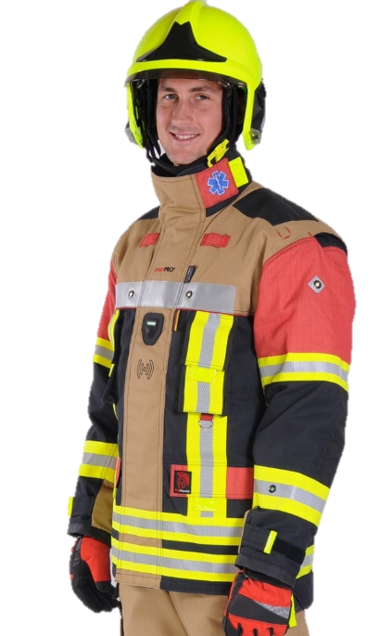
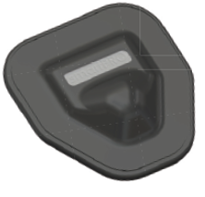
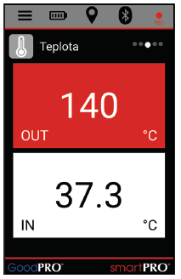
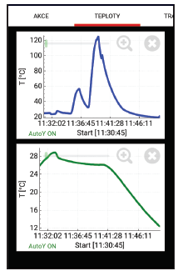
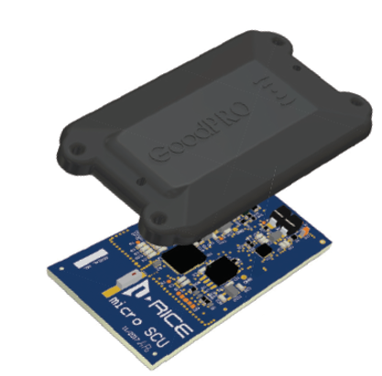
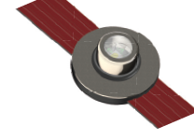
2.2 ADVANTEX Project - SmartPro2 suit
Emergency strip
Temperature sensors
Control button
Active LED illumination
Suit control unit
(black box function)
LED indicator

Slide 16
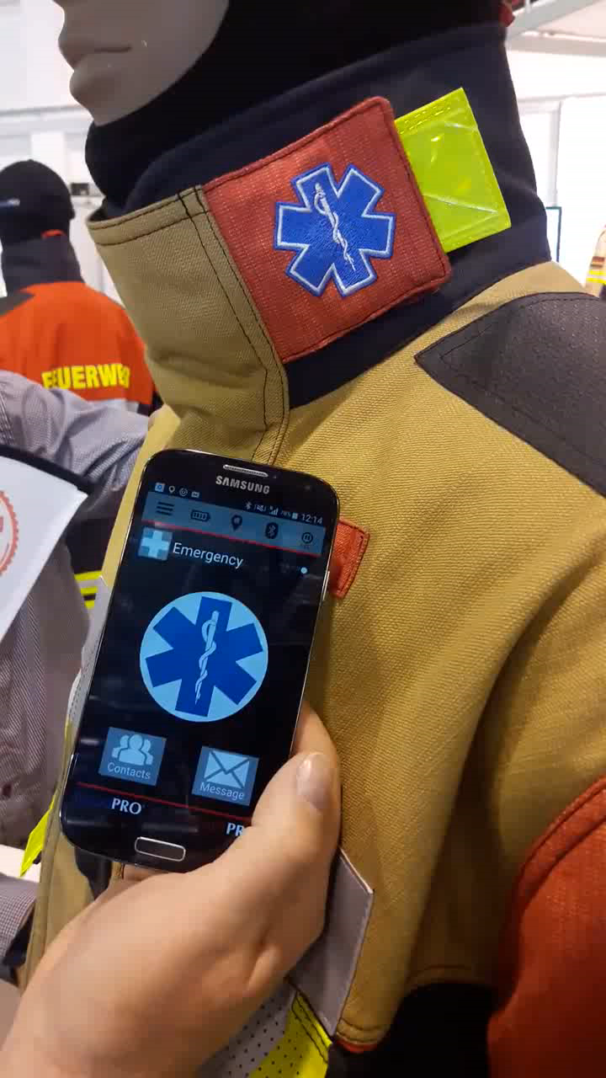
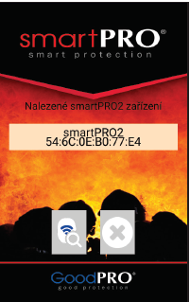
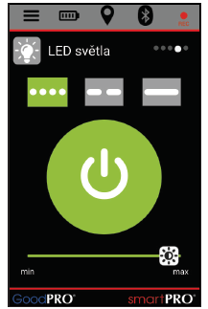
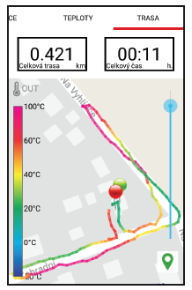
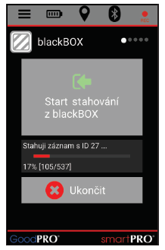
2.2 ADVANTEX Project – SmartPro2 suit
Screenshots from the SW application.
Emergency strip – video.

Slide 17
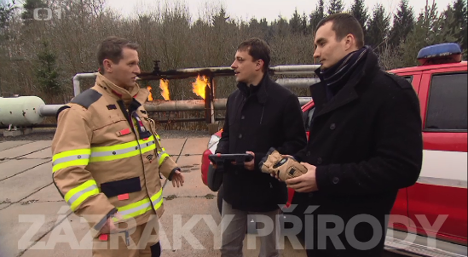



2.2 ADVANTEX Project - Achievements
Dissemination of the results 5 papers were published (1 in an impact journal, 4 in conference proceedings). 5 keynote and invited presentations at the international conferences Project result presented at 11 international trade fairs (e.g. Interschutz, A+A, Florian etc.)
IP protection of the results European patent for Protective glove pending. 5 utility models granted, 1 industrial design granted.
Awards reddot award 2018 (glove). GOLDEN AMPER - the most beneficial showpieces of the international fair AMPER 2017 (suit)
The Czech consortium succeeded in the final round of the smart@fire Pre-commercial Procurement tender.
Media release of the smart suit and glove in the Czech national TV, Czech national radio and press.
The smart glove was introduced to the market in December 2017. The smart suit will be introduced within a year.

Slide 18

ASES project

Slide 19




2.3 ASES Project
ASES - Smart High Efficient Alternative Solar Energy
Project duration | May 2014 - April 2018
Program Funding provider | EURIPIDES2 – EUREKA, MSMT (CZ)
Project description
The goal of this project is to develop a smart and reliable high efficient renewable energy source covers the energy needs between 20 Wh/day for very low power sensors and few kWh/day for power systems. Next goal is to develop new technologies for the construction of new generation of CPV receivers (e.g. Thick Printed Copper).
Target applications
CPV energy generators for safety and security of the people: environment surveillance, smart autonomous medium power generator, secure communication, isolated process networks, video surveillance, emergency situations.
Consorcium overview
ERYMA - France, TECNALIA – Spain, BSQ – Spain, ELCERAM – Czech Republic, University of West Bohemia – Czech Republic

Slide 20







2.3 ASES Project - Experiences with an EEN offer
Our EEN offer.
BIC
Pilsen
Title: Eureka - Mobile Energy Supply Solution
(Ref: 12 CZ 0746 3QAR)
Abstract:
A Czech university in cooperation with a Czech SME are preparing a project proposal to Eureka programme. The project goal is a development of a solar mobile energy source based on concentrated photovoltaics. The university is looking for project partners (preferably companies or possibly universities) aimed at electronics, chassis design, telecommunication or possibly photovoltaics or production of batteries.
Description:
There is a need to use a mobile energy solution in case of emergency (fires, accidents, etc.) or absence of power lines (remote communications, electronic mobile devices, mobile field hospitals, laboratories, etc.). Government offices, law enforcement in developing countries or fire departments frequently use generators at remote sites. Generators are noisy and unreliable, often breaking down or not starting in...
EEN
offer
Assistance with the offer
preparation.
We received several EoI.
We chose Tecnalia.
idea
ASES
project
We had a project idea.

Slide 21




2.3 ASES Project
Substrates for power electronics based on Thick Printed Copper Technology (TPC)
Substitution to conventional Direct Bonded Copper (DBC) with many advantages:
  Additive manufacturing process – material savings.
  Higher pattern resolution compared to DBC (down to 100 µm line/gap).
  Step & Relief thickness profile (Cu thickness from 25 µm to 300 µm on one substrate).
  Cu plated vias and multilayer circuits capability.
  Direct integration of passive component and sensors.
  Assembly of fine pitch SMD components.
Temperature shock cycles test
(-50 °C / 150 °C).
170
cycles
Conventional DBC Technology.
1000
cycles
Thick Printed Copper (TPC) Technology.

Slide 22





2.3 ASES Project – new technologies for manufacturing
Vacuum pump outlet + valve
N₂ inlet
+ valve
Low-void vacuum soldering.
Heating plate
Furnace control
Pressure
sensor
Temperature control
Vacuum furnace chamber
Vacuum and nitrogen furnace for TPC firing.
Vacuum / N2 reflow owen for low-void soldering.
Soldered top electrodes.

Slide 23




2.3 ASES Project
Sun tracker
Cu base.
Al base.
CPV receivers developed and realized by ELCERAM with close collaboration with UWB.
The complete ASES CPV system
(25% of efficiency at the CPV outputs).

Slide 24



2.3 ASES Project
Example of new applications
Example of new application – the High / Low beam for Skoda Octavia III
Power rectifier 1700 V / 100 A with temperature and current sensing.

Slide 25


2.3 ASES Project
Dissemination of the results 7 papers were published (2 in an impact journal, 5 in conference proceedings). 5 presentations at the international conferences Project result presented at 2 international trade fairs (e.g. ELECTRONICA, PRODUCTRONICA)
IP protection of the results 1 patent granted. 2 utility models granted.
Media release of the project results in 5 press media and Czech national radio „Radiožurnal“.
4000 CPV receivers done by TPC technology sold to BSQ (installed in UAE - 100 kW CPV power plant).
New technology for direct selective printing of Copper on Alumina substrate (TPC) was developed and implemented in pilot production.
New technology for direct selective printing of Copper on Alumina substrate (TPC) was developed.
ASES CPV system was successfully tested at 4 locations (France, Spain, Czech Republic).

Slide 26
3. Conclusions
We have a good experience with EUREKA EURIPIDES cluster projects (INTEX – success story project, ADVANTEX and ASES).
Benefits of the cluster projects: bottom-up project, market-oriented, industrial R&D, ability to build European ecosystem covering the whole value chain, reasonable project preparation investment versus chance to success and easy access for SMEs.
Thanks to international cooperation in the presented projects new products and technologies were developed.
The first project results have been already commercialized.
Industrial partners expand international cooperation with world renowned companies and institutions.
Thanks to Enterprise Europe Network (EEN) platform we could start ASES project.
The collaboration among partners in all projects was effective and proceeded in a friendly and creative atmosphere under kind and effective support of the EURIPIDES OFFICE in Paris and the national authorities.

Slide 27

Thank you for your attention
Radek Soukup
UWB, Czech Republic
rsoukup@ket.zcu.cz
+420377634542

